Slide 1
Basics of NS-2 Training in TCL script
Presented by: M. Viju Prakash, M.E., Ph.D.
Date: 27 – 01 – 2017
Venue: Photon Lab, RSET.

Slide 2
Contents:
Objectives of this seminar
What is NS-2?
Installing NS-2 in Ubuntu/Debian
Working with TCL (Tool Command Language)
Tutorial exercise
NS-2 internals
Extending NS-2

Slide 3
Objectives of this seminar
Get some exposure to one of the most useful tools in networking research and development.
Understand and work with a popular network simulator.
Get a better understanding of the networking dynamics.

Slide 4
What is NS-2?
NS-2 stands for Network Simulator version 2.
Characteristics:
It is a discrete event simulator for networking research.
Object oriented simulator.
Work at packet level.
Provide substantial support to simulate bunch of protocols like TCP, UDP, FTP, HTTP and DSR.
Simulate wired and wireless network.
It is primarily Unix based.
Use TCL as its scripting language.

Slide 5
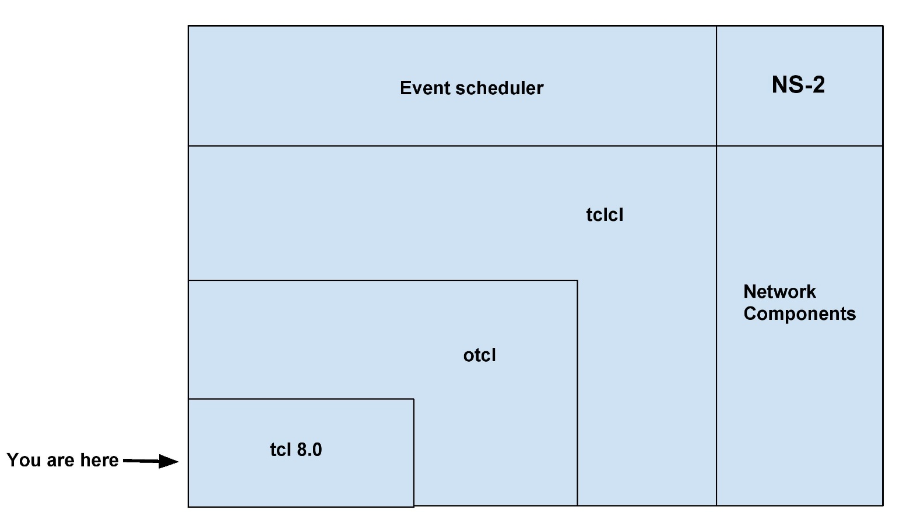
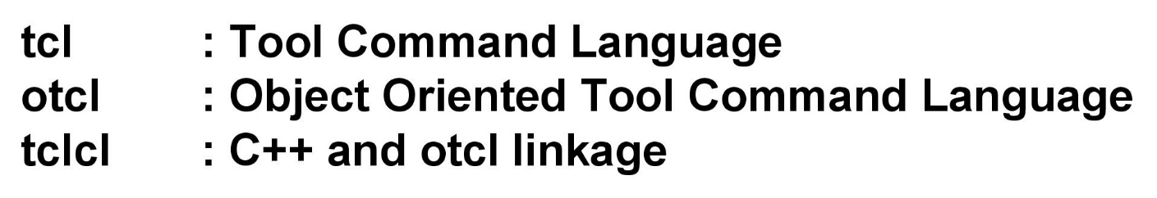
What is NS-2 (contd.) ?

Slide 6
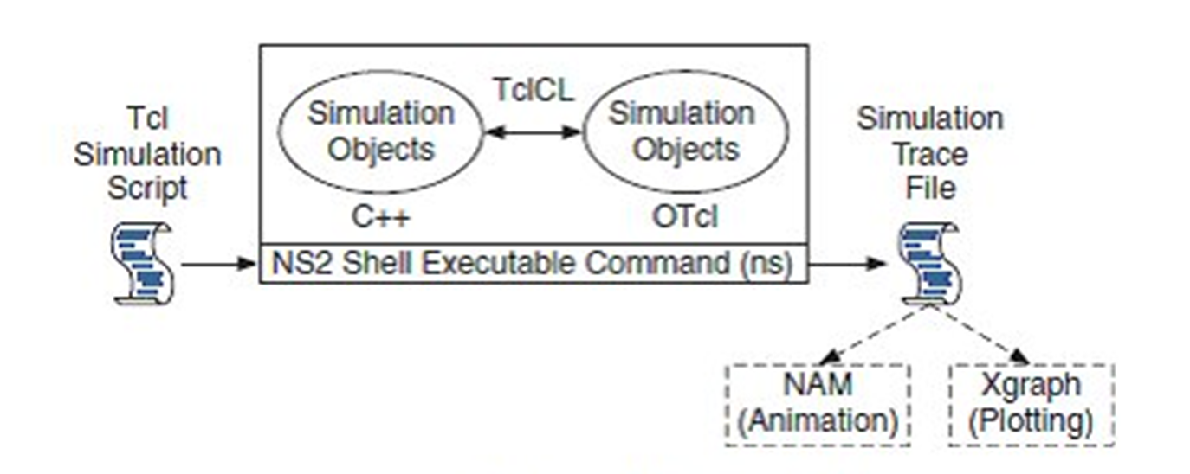
Basic architecture of NS-2

Slide 7
Why two language? (tcl & C++)
C++: Detailed protocol simulations require systems programming language
byte manipulation, packet processing, algorithm implementation
While the C++ defines the internal mechanism (i.e., a backend) of the simulation objects, the otcl sets up simulation by assembling and configuring the objects as well as scheduling discrete events.
The C++ and the otcl are linked together using tclcl.
Turn around time (run simulation, find bug, fix bug, recompile, re-run) is slower.
tcl: Simulation of slightly varying parameters or configurations
quickly exploring a number of scenarios
iteration time (change the model and re -run) is more important

Slide 8
Installing NS-2 in Linux platforms
1. Choose a Linux flavor which has long term support.
2. Install Linux with complete packages. Don’t skip any component from installation.
3. Download NS2 All In One Package from following link:
http://sourceforge.net/projects/nsnam/files/allinone/ns-allinone-2.34/
Official Website:
http://www.isi.edu/nsnam/ns/

Slide 9
Installing NS-2 in Linux platforms
4. Now extract NS-2 by using the following command. Go to the folder where you stored NS-2 installation files.
Ex: /home/user_name/Documents
Then type the following command
tar -xvzf ns-allinone-2.35.tar.gz

Slide 10
Installing NS-2 in Linux platforms
5. Now go to ns-allinone-2.35 and type the following commands
$ sudo apt-get install build-essential autoconf automake libxmu-dev
$ sudo apt-get install -f build-essential libxt-dev libxt6 libsm-dev libsm6 libice-dev libice6 libxmu-dev
6. Install NS2 using following command.
$./install
It will take some time.

Slide 11
Installing NS-2 in Linux platforms
7. Set environment variables now. Use a new terminal window to edit environment variables.
$ gedit ~/.bashrc

Slide 12
Installing NS-2 in Linux platforms
8. Set the Environment Variables
Now that NS is installed, there are some environment variables that need to be added to our profile. This can be done by editing the .bashrc file. Open a new terminal and open the file using:
sudo gedit .bashrc

Slide 13
# LD_LIBRARY_PATH
OTCL_LIB=/home/user_name/ns-allinone-2.35/otcl-1.14
NS2_LIB=/home/user_name/ns-allinone-2.35/lib
X11_LIB=/usr/X11R6/lib
USR_LOCAL_LIB=/usr/local/lib
export LD_LIBRARY_PATH=$LD_LIBRARY_PATH:
$OTCL_LIB:$NS2_LIB:$X11_LIB:$USR_LOCAL_LIB
# TCL_LIBRARY
TCL_LIB=/home/user_name/ns-allinone-2.35/tcl8.5.10/library
USR_LIB=/usr/lib
export TCL_LIBRARY=$TCL_LIB:$USR_LIB
# PATH
XGRAPH=/home/user_name/ns-allinone-2.35/bin:/home/user_name/ns-allinone-2.35/tcl8.5.10/unix:/home/user_name/ns-allinone-2.35/tk8.5.10/unix
NS=/home/user_name/ns-allinone-2.35/ns-2.35/
NAM=/home/user_name/ns-allinone-2.35/nam-1.15/
PATH=$PATH:$XGRAPH:$NS:$NAM

Slide 14
Installing NS-2 in Linux platforms
9. Save the file and restart the system, alternatively you can just reload the .bashrc as:
source ~/.bashrc
10. Validating the installation
We need to validate NS-2 to check if everything is OK but keep in mind that it will take lot of time. Open up a terminal and move to the directory
‘/home/user_name/Documents/ns-allinone-2.35/ns-2.35/' and run:
./validate
Depending on system performance, this command may take up to 90 minutes.

Slide 15
Installing NS-2 in Linux platforms
11. You can now run NS-2 from a terminal window by executing: ns If you received the "%" sign, it means that NS is running.
Note: If nam (Network AniMator) is not working or showing an error like “core dumped. Segmentation fault”, remove nam installation by using the following command.
sudo apt-get remove nam
Download the updated nam from the following link and install it.
https://drive.google.com/file/d/0B7S255p3kFXNNmtLeXhsaG5hXzQ/edit?pli=1

Slide 16
Working with TCL
After the installation, NS-2 can be invoked by executing the following statement in terminal window:
$ ns <file.tcl> <args>
Both are optional input arguments. If we prepared a TCL file earlier, it can be specified here. Else NS-2 waits to interpret commands from keyboard. It is a line-by-line method.

Slide 17
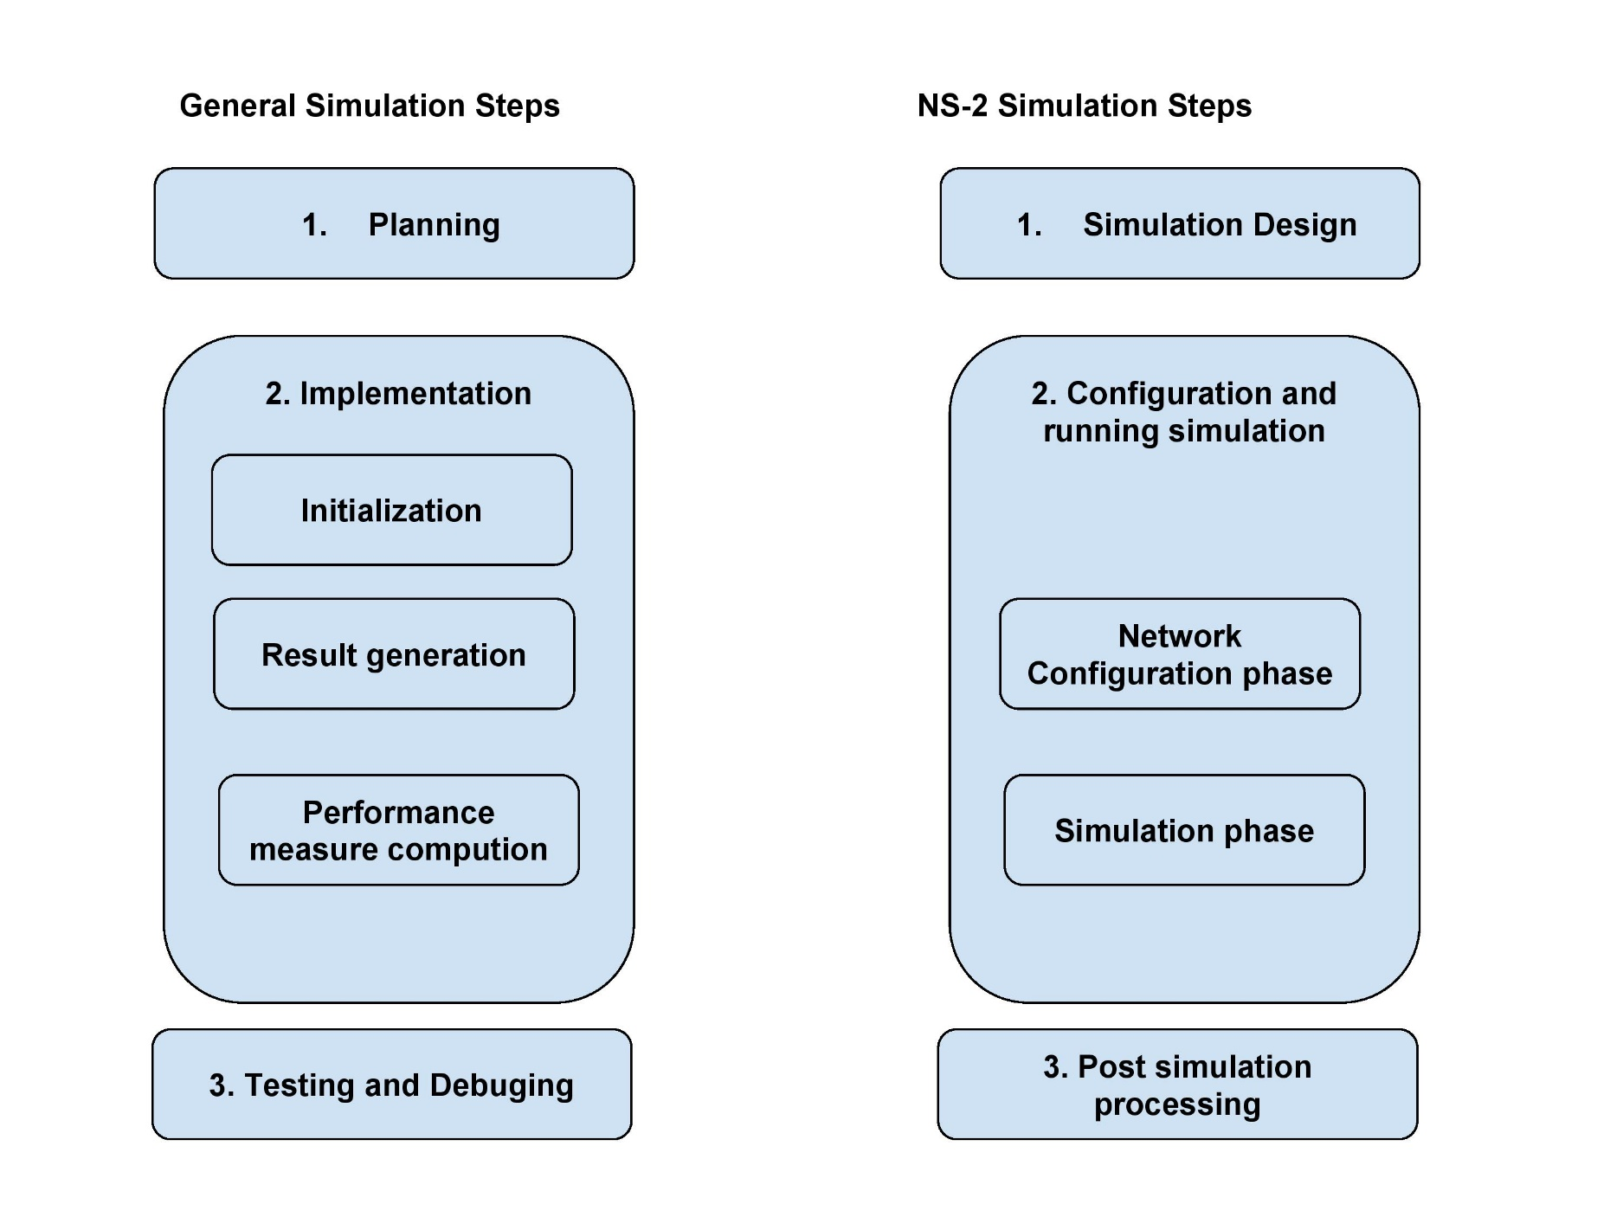
A comparison of general simulation and NS-2 simulation

Slide 18
1. Simulation design
The first step in simulating a network is to design the simulation. In the step, the user should determine the simulation purposes, network configuration, assumptions, measures and the type of expected results.

Slide 19
2. Configuring and running simulation
It consists of two phases:
Network configuration phase
Simulation phase
Network configuration phase: In this phase, network components (e.g. nodes, TCP, UDP…) are created and configured according to the simulation design.
Simulation phase: It maintains simulation clock and executes events chronologically.

Slide 20
Our work areas in NS-2
TCL editor
Our programming window
Network Animator (NAM) (Ex:- filename.nam)
Animation can be shown in this window
Trace file (Ex:- filename.tr)
Post-simulation analysis can be done by using trace file.

Slide 21
Working with TCL (wired network)

Slide 22
Topology Description
Network consists of 5 nodes (n0, n1, n2, n3, n4).
The duplex links between n0 and n2, and n1 and n2 have 100 Mbps of bandwidth and 5 ms of delay.
The duplex link between n2 and n3 and n2 and n4 has 54 Mbps of bandwidth and 10 ms of delay.
The duplex link between n3 and n4 has 10 Mbps of bandwidth and 15 ms of delay.
Each node uses a DropTail queue, of which the maximum size is 10.
A “tcp” agent is attached to n1, and a connection is established to a tcp “sink” agent attached to n4.
As default, the maximum size of a packet that a “tcp” agent can generate is 1KByte.
A tcp “sink” agent generates and sends ACK packets to the sender (tcp agent) and frees the received packets.
A “udp” agent that is attached to n0 is connected to a “null” agent attached to n3.
A “null” agent just frees the packets received.
A “ftp” and a “cbr” traffic generator are attached to “tcp” and “udp” agents respectively,
The “cbr” is configured to generate 1 KByte packets at the rate of 1 Mbps.
The “cbr” is set to start at 0.1 sec and stop at 60.5 sec, and “ftp” is set to start at 0.05 sec and stop at 60.0 sec.

Slide 23
Definition of Various technical words
In communication networks, a node is either a redistribution point (e.g. data communications equipment), or a communication endpoint (e.g. data terminal equipment). The definition of a node depends on the network and protocol layer referred to.
Bandwidth is defined as the amount of data that can be transmitted in a fixed amount of time. For digital devices, the bandwidth is usually expressed in bits per second(bps) or bytes per second.
The delay of a network specifies how long it takes for a bit of data to travel across the network from one node or endpoint to another. It is typically measured in multiples or fractions of seconds.

Slide 24
My first TCL Program Create simulator, trace & NAM
# Create a Simulator
set ns [new Simulator]
# Create a trace file
set mytrace [open out.tr w]
$ns trace-all $mytrace
# Create a NAM trace file
set myNAM [open out.nam w]
$ns namtrace-all $myNAM

Slide 25
Next, define a procedure finish{}
# Define a procedure finish
proc finish { }
{
global ns mytrace myNAM
$ns flush-trace
close $mytrace
close $myNAM
exec nam out.nam &
exit 0
}

Slide 26
Next, create necessary nodes
# Create Nodes
set n0 [$ns node]
set n1 [$ns node]
set n2 [$ns node]
set n3 [$ns node]
set n4 [$ns node]

Slide 27
Next, connect nodes with links
# Connect Nodes with Links
$ns duplex-link $n0 $n2 100Mb 5ms DropTail
$ns duplex-link $n1 $n2 100Mb 5ms DropTail
$ns duplex-link $n2 $n4 54Mb 10ms DropTail
$ns duplex-link $n2 $n3 54Mb 10ms DropTail
$ns simplex-link $n3 $n4 10Mb 15ms DropTail

Slide 28
Create a UDP Agent & Create CBR traffic Source
# Create a UDP agent
set udp [new Agent/UDP]
$ns attach-agent $n0 $udp #UDP Agent is connected to n0
set null [new Agent/Null]
$ns attach-agent $n3 $null #Null Agent is connected to n3
$ns connect $udp $null #UDP source and destination is connected
# Create a CBR traffic source
set cbr [new Application/Traffic/CBR]
$cbr attach-agent $udp

Slide 29
Create a TCP Agent & Create an FTP Session
# Create a TCP agent
set tcp [new Agent/TCP]
$ns attach-agent $n1 $tcp
set sink [new Agent/TCPSink]
$ns attach-agent $n4 $sink
$ns connect $tcp $sink
# Create an FTP session
set ftp [new Application/FTP]
$ftp attach-agent $tcp

Slide 30
Schedule the events
# Schedule events
$ns at 0.05 "$ftp start"
$ns at 0.1 "$cbr start"
$ns at 60.0 "$ftp stop"
$ns at 60.5 "$cbr stop"
$ns at 61 "finish"

Slide 31
Final step is, start the simulation
# Start the simulation
$ns run
Now save and close TCL window, go to terminal and move to location of the file. Type the following command in terminal window:
ns <filename>.tcl

Slide 32
Apart from .tcl
Now you can see two more files that were created during the execution of TCL files.
<file.nam> where as file is the name you selected in TCL program.
<file.tr> where as file is the name you selected in TCL program.

Slide 33
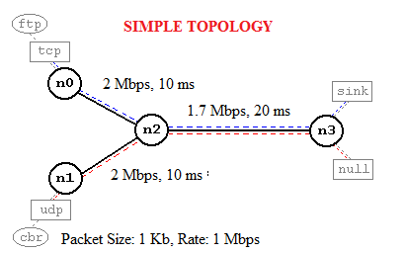
Additional options in Wired Networks

Slide 34
Topology Description
Network consists of 4 nodes (n0, n1, n2, n3).
The duplex links between n0 and n2, and n1 and n2 have 2 Mbps of bandwidth and 10 ms of delay.
The duplex link between n2 and n3 has 1.7 Mbps of bandwidth and 20 ms of delay.
Each node uses a DropTail queue, of which the maximum size is 10.
A “tcp” agent is attached to n0, and a connection is established to a tcp “sink” agent attached to n3.
As default, the maximum size of a packet that a “tcp” agent can generate is 1KByte.
A tcp “sink” agent generates and sends ACK packets to the sender (tcp agent) and frees the received packets.
A “udp” agent that is attached to n1 is connected to a “null” agent attached to n3.
A “null” agent just frees the packets received.
A “ftp” and a “cbr” traffic generator are attached to “tcp” and “udp” agents respectively,
The “cbr” is configured to generate 1 KByte packets at the rate of 1 Mbps.
The “cbr” is set to start at 0.1 sec and stop at 4.5 sec, and “ftp” is set to start at 1.0 sec and stop at 4.0 sec.

Slide 35
Define simulator object & colors for data flows
#Create a simulator object
set ns [new Simulator]
#Define different colors for data flows (for NAM)
$ns color 1 Blue
$ns color 2 Red

Slide 36
Open NAM and define finish procedure
#Open the NAM trace file
set nf [open out.nam w]
$ns namtrace-all $nf
#Define a 'finish' procedure
proc finish {} {
global ns nf
$ns flush-trace
#Close the NAM trace file
close $nf
#Execute the NAM
exec nam out.nam &
exit 0
}

Slide 37
Create four nodes
#Create four nodes
set n0 [$ns node]
set n1 [$ns node]
set n2 [$ns node]
set n3 [$ns node]

Slide 38
Create links between the nodes
#Create links between the nodes
$ns duplex-link $n0 $n2 2Mb 10ms DropTail
$ns duplex-link $n1 $n2 2Mb 10ms DropTail
$ns duplex-link $n2 $n3 1.7Mb 20ms DropTail

Slide 39
Set a queue size and node position
#Set Queue Size of link (n2-n3) to 10
$ns queue-limit $n2 $n3 10
#Give node position (for NAM)
$ns duplex-link-op $n0 $n2 orient right-down
$ns duplex-link-op $n1 $n2 orient right-up
$ns duplex-link-op $n2 $n3 orient right
#Monitor the queue for link (n2-n3). (for NAM)
$ns duplex-link-op $n2 $n3 queuePos 0.5

Slide 40
Create a TCP connection and FTP over TCP
#Setup a TCP connection
set tcp [new Agent/TCP]
$ns attach-agent $n0 $tcp
set sink [new Agent/TCPSink]
$ns attach-agent $n3 $sink
$ns connect $tcp $sink
$tcp set fid_ 1
#Setup a FTP over TCP connection
set ftp [new Application/FTP]
$ftp attach-agent $tcp
$ftp set type_ FTP

Slide 41
Create an UDP Agent
#Setup a UDP connection
set udp [new Agent/UDP]
$ns attach-agent $n1 $udp
set null [new Agent/Null]
$ns attach-agent $n3 $null
$ns connect $udp $null
$udp set fid_ 2

Slide 42
An Enhanced CBR can be defined here
#Setup a CBR over UDP connection
set cbr [new Application/Traffic/CBR]
$cbr attach-agent $udp
$cbr set type_ CBR
$cbr set packetSize_ 1000
$cbr set rate_ 1mb
$cbr set interval_ 0.001
$cbr set random_ false

Slide 43
Schedule the events
#Schedule events for the CBR and FTP agents
$ns at 0.1 "$cbr start"
$ns at 1.0 "$ftp start"
$ns at 4.0 "$ftp stop"
$ns at 4.5 "$cbr stop"

Slide 44
Final steps
#Call the finish procedure after 5 seconds of simulation time
$ns at 5.0 "finish"

Slide 45
Print CBR parameters on the screen and Run
#Print CBR packet size and interval
puts "CBR packet size = [$cbr set packetSize_]"
puts "CBR interval = [$cbr set interval_]“
#Run the simulation
$ns run

Slide 46
Tutorial-1 (Network topology design is here)
Network consists of 6 nodes (n0, n1, n2, n3, n4, n5).
The duplex links between n0 and n2, and n1 and n2 have 1 Mbps of bandwidth and 10 ms of delay.
The duplex link between n2 and n3 has 3 Mbps of bandwidth and 10 ms of delay.
The duplex link between n3 and n5, and n3 and n4 has 2 Mbps of bandwidth and 10 ms of delay.
Each node uses a DropTail queue, of which the maximum size is 10. (Decide a suitable link)
A “tcp” agent is attached to n0, and a connection is established to a tcp “sink” agent attached to n5.
As default, the maximum size of a packet that a “tcp” agent can generate is 1KByte.
A tcp “sink” agent generates and sends ACK packets to the sender (tcp agent) and frees the received packets.
A “udp” agent that is attached to n1 is connected to a “null” agent attached to n4.
A “null” agent just frees the packets received.
A “ftp” and a “cbr” traffic generator are attached to “tcp” and “udp” agents respectively,
The “cbr” is configured to generate 1 KByte packets at the rate of 1 Mbps.
The “cbr” is set to start at 2.5 sec and stop at 4.5 sec, and “ftp” is set to start at 0.1 sec and stop at 4.5 sec.
Set the packet size and interval of both CBR and FTP is 500 and 0.005 sec

Slide 47
Solution of Tutorial-1
set n0 [$ns node]
set n1 [$ns node]
set n2 [$ns node]
set n3 [$ns node]
set n4 [$ns node]
set n5 [$ns node]
$ns duplex-link $n0 $n2 1Mb 10ms DropTail
$ns duplex-link $n1 $n2 1Mb 10ms DropTail
$ns duplex-link $n2 $n3 3Mb 10ms DropTail
$ns duplex-link $n3 $n5 2Mb 10ms DropTail
$ns duplex-link $n3 $n4 2Mb 10ms DropTail

Slide 48
Solution of Tutorial-1 (contd…)
set udp0 [new Agent/UDP] $ns attach-agent $n1 $udp0 set cbr0 [new Application/Traffic/CBR] $cbr0 set packetSize_ 500 $cbr0 set interval_ .005 $cbr0 attach-agent $udp0
set tcp0 [new Agent/TCP] $ns attach-agent $n0 $tcp0 set ftp0 [new Application/FTP] $ftp0 set packetSize_ 500 $ftp0 set interval_ .005 $ftp0 attach-agent $tcp0

Slide 49
Solution of Tutorial-1 (contd…)
set sink0 [new Agent/TCPSink] $ns attach-agent $n5 $sink0
set null0 [new Agent/Null] $ns attach-agent $n4 $null0 $ns connect $udp0 $null0 $ns connect $tcp0 $sink0 $ns at 0.1 "$ftp0 start" $ns at 2.5 "$cbr0 start" $ns at 4.5 "$ftp0 stop" $ns at 4.5 "$cbr0 stop" $ns at 5.0 "finish"

Slide 50
Post Simulation Analysis
Two types of tracing available
Text based tracing
NAM packet tracing
Text-Based Packet Tracing – records the detail of packets passing through network checkpoints in text. It’s our trace file.
NAM trace records the simulation events in text file and play back the simulation using animation. NAM trace can be activated by the command
$ns namtrace-all $file
#Example:
set nf [open out.nam w]
$ns namtrace-all $nf

Slide 51
Text based tracing

Slide 52
Format of each line
12 columns make up a complete trace line
Type identifier event corresponds to four possible event types
“r” received
“+” enqueued
“-” dequeued
“d” dropped

Slide 53
Explanation about each line
The time field denotes the time at which such event occurs.
Fields 3 and 4 are the starting and the terminating nodes respectively.
Fields 5 and 6 are packet type and packet size, respectively.
Field 7 is a series of flags, indicating any abnormal behavior. Note the output "-------" denotes no flag.
Field 8 is packet flow ID.
Fields 9 and 10 mark the source and the destination addresses, respectively, in the form of node.port.
For correct packet assembly at the destination node, NS-2 specifies a packet sequence number in the second last field.
Finally, to keep track of all packets, a packet unique ID is recorded in the last field.

Slide 54
NAM: Network AniMation Trace
NAM trace records the simulation events in text file and play back the simulation using animation. NAM trace can be activated by the command
$ns namtrace-all $file
To execute a nam file, type the following command. Remember, it will not refresh trace or tcl files.
nam filename.nam

Slide 55
Post-simulation using AWK files
awk (also written as Awk and AWK) is a utility that enables a programmer to write tiny but effective programs in the form of statements that define text patterns that are to be searched for in each line of a document and the action that is to be taken when a match is found within a line.
To install AWK, type the command in terminal
sudo apt-get install gawk

Slide 56
To work in AWK file, let’s look it closer (tcp.awk)
#!/usr/bin/awk -f BEGIN{ #print "Throughput calculation" data=0 } { if ( $1=="r" && $4=="5" && $5=="tcp" ) { data += $6 print $2,data*8.0/$2/1000000 } } END{ #print "Completed" }

Slide 57
Now look udp.awk
#!/usr/bin/awk -f BEGIN{ #print "Throughput calculation" data=0 } { if ( $1=="r" && $4=="4" && $5=="cbr" ) { data += $6 print $2,data*8.0/$2/1000000 } } END{ #print "Completed" }

Slide 58
How to use these AWK files in NS-2?
Follow these steps carefully!
Assume that, your trace file has a name out.tr
Then execute the following commands:
awk -f tcp.awk out.tr > tcp.dat
awk –f udp.awk out.tr > udp.dat
xgraph tcp.dat udp.dat

Slide 59
Difference between Link state and Distance Vector Protocols
Distance vector is one of Dynamic Routing protocol. Dynamic routing protocol periodically send information about its known routes to their connected neighbors. Distance vector protocols are slow and have chances for loops. It checks received routing table and update it periodically.
Link state routing protocols are different. Routers send the information about the state of their links and there are a part of it. In this way, entire routers understand network topology. They run an algorithm every time a network change is announced to recalculates the best routes throughout the network.

Slide 60
Look at distance vector TCL script (dv.tcl)
set ns [new Simulator] $ns rtproto DV set nt [open dv.tr w] $ns trace-all $nt set nm [open dv.nam w] $ns namtrace-all $nm proc finish {} { global nt nm ns $ns flush-trace close $nt close $nm exec nam dv.nam & exit 0 }

Slide 61
Contd… (dv.tcl)
for {set i 0} {$i < 12} {incr i} { set n$i [$ns node] } $ns duplex-link $n0 $n1 1Mb 10ms DropTail $ns duplex-link $n1 $n2 1Mb 10ms DropTail $ns duplex-link $n2 $n3 1Mb 10ms DropTail $ns duplex-link $n3 $n4 1Mb 10ms DropTail $ns duplex-link $n4 $n5 1Mb 10ms DropTail $ns duplex-link $n5 $n6 1Mb 10ms DropTail $ns duplex-link $n6 $n7 1Mb 10ms DropTail $ns duplex-link $n7 $n8 1Mb 10ms DropTail $ns duplex-link $n0 $n8 1Mb 10ms DropTail $ns duplex-link $n0 $n9 1Mb 10ms DropTail $ns duplex-link $n1 $n10 1Mb 10ms DropTail $ns duplex-link $n9 $n11 1Mb 10ms DropTail $ns duplex-link $n10 $n11 1Mb 10ms DropTail $ns duplex-link $n11 $n5 1Mb 10ms DropTail

Slide 62
Contd… (dv.tcl) 2 UDP Agents created
set udp0 [new Agent/UDP] $ns attach-agent $n0 $udp0 set cbr0 [new Application/Traffic/CBR] $cbr0 attach-agent $udp0 $cbr0 set packetSize_ 500 $cbr0 set interval_ 0.005
set udp1 [new Agent/UDP] $ns attach-agent $n1 $udp1
set cbr1 [new Application/Traffic/CBR] $cbr1 attach-agent $udp1 $cbr1 set packetSize_ 500 $cbr1 set interval_ 0.005

Slide 63
Contd… (dv.tcl) 2 UDP destinations created
set sink0 [new Agent/Null] $ns attach-agent $n5 $sink0 set sink1 [new Agent/Null] $ns attach-agent $n5 $sink1
#Connect source and destination
$ns connect $udp0 $sink0 $ns connect $udp1 $sink1

Slide 64
Illusion of Routing table updating time
$ns rtmodel-at 10.0 down $n11 $n5 $ns rtmodel-at 30.0 up $n11 $n5 $ns rtmodel-at 15.0 down $n7 $n6 $ns rtmodel-at 20.0 up $n7 $n6
$ns at 5.0 "$cbr0 start" $ns at 5.0 "$cbr1 start" $ns at 45.0 "$cbr0 stop" $ns at 45.0 "$cbr1 stop" $ns at 50.0 "finish" $ns run

Slide 65
Look at Link State TCL script (ls.tcl)
set ns [new Simulator] $ns rtproto LS set nt [open ls.tr w] $ns trace-all $nt set nm [open ls.nam w] $ns namtrace-all $nm proc finish {} { global nt nm ns $ns flush-trace close $nt close $nm exec nam dv.nam & exit 0 }

Slide 66
Continuation of Link State TCL script (ls.tcl)
for {set i 0} {$i < 12} {incr i} { set n$i [$ns node] } $ns duplex-link $n0 $n1 1Mb 10ms DropTail $ns duplex-link $n1 $n2 1Mb 10ms DropTail $ns duplex-link $n2 $n3 1Mb 10ms DropTail $ns duplex-link $n3 $n4 1Mb 10ms DropTail $ns duplex-link $n4 $n5 1Mb 10ms DropTail $ns duplex-link $n5 $n6 1Mb 10ms DropTail $ns duplex-link $n6 $n7 1Mb 10ms DropTail $ns duplex-link $n7 $n8 1Mb 10ms DropTail $ns duplex-link $n0 $n8 1Mb 10ms DropTail $ns duplex-link $n0 $n9 1Mb 10ms DropTail $ns duplex-link $n1 $n10 1Mb 10ms DropTail $ns duplex-link $n9 $n11 1Mb 10ms DropTail $ns duplex-link $n10 $n11 1Mb 10ms DropTail $ns duplex-link $n11 $n5 1Mb 10ms DropTail

Slide 67
Continuation of Link State TCL script (ls.tcl)
set udp0 [new Agent/UDP] $ns attach-agent $n0 $udp0 set cbr0 [new Application/Traffic/CBR] $cbr0 attach-agent $udp0 $cbr0 set packetSize_ 500 $cbr0 set interval_ 0.005
set udp1 [new Agent/UDP] $ns attach-agent $n1 $udp1
set cbr1 [new Application/Traffic/CBR] $cbr1 attach-agent $udp1 $cbr1 set packetSize_ 500 $cbr1 set interval_ 0.005

Slide 68
Contd… (ls.tcl) 2 UDP destinations created
set sink0 [new Agent/Null] $ns attach-agent $n5 $sink0 set sink1 [new Agent/Null] $ns attach-agent $n5 $sink1
#Connect source and destination
$ns connect $udp0 $sink0 $ns connect $udp1 $sink1

Slide 69
Illusion of Router updating time
$ns rtmodel-at 10.0 down $n11 $n5 $ns rtmodel-at 30.0 up $n11 $n5 $ns rtmodel-at 15.0 down $n7 $n6 $ns rtmodel-at 20.0 up $n7 $n6 $ns at 5.0 "$cbr0 start" $ns at 5.0 "$cbr1 start" $ns at 45.0 "$cbr0 stop" $ns at 45.0 "$cbr1 stop" $ns at 50.0 "finish" $ns run

Slide 70
dv.awk
#!/usr/bin/awk -f BEGIN{ print "DV calculation starts...." routing=0 sent=0 received=0 dropped=0 noh=0 pdr=0 } { if ( $1=="r" && $5=="rtProtoDV" ) { routing +=1 } if ( $1=="+" && $3=="0" && $5=="cbr" ) { sent +=1 } if ( $1=="+" && $3=="1" && $5=="cbr" ) { sent +=1 } if ( $1=="r" && $4=="5" && $5=="cbr" ) { received +=1 } if ( $1=="d" ) { dropped +=1 } } END{ noh =routing/received pdr =received/sent print "Routing packets :",routing print "Sent packets :",sent print "Received packets :",received print "Dropped packets :",dropped print "Normalized Over Head[NOH] :",noh print "Packet Delivery Ratio[PDR] :",pdr print "Evaluation Completed" }

Slide 71
ls.awk
#!/usr/bin/awk -f BEGIN{ print "LS calculation starts....." routing=0 sent=0 received=0 dropped=0 noh=0 pdr=0 } { if ( $1=="r" && $5=="rtProtoLS" ) { routing +=1 } if ( $1=="+" && $3=="0" && $5=="cbr" ) { sent +=1 } if ( $1=="+" && $3=="1" && $5=="cbr" ) { sent +=1 } if ( $1=="r" && $4=="5" && $5=="cbr" ) { received +=1 } if ( $1=="d" ) { dropped +=1 } } END{ noh =routing/received pdr =received/sent print "Routing packets :",routing print "Sent packets :",sent print "Received packets :",received print "Dropped packets :",dropped print "Normalized Over Head [NOH] :",noh print "Packet Delivery Ratio [PDR] :",pdr print "Completed..." }

Slide 72
Difference between DropTail, RED & SFQ
Drop Tail:
It is a simple queue mechanism that is used by the routers that when packets should to be drop. In this mechanism each packet is treated identically and when queue filled to its maximum capacity the newly incoming packets are dropped until queue have sufficient space to accept incoming traffic.
Problem:
When a queue is filled the router start to discard all extra packets thus dropping the tail of mechanism. The loss of packets causes the sender to enter slow start which decreases the throughput and thus increases its congestion window.

Slide 73
Difference between DropTail, RED & SFQ
RED:
Random Early Detection (RED) is a congestion avoidance queuing mechanism that is potentially useful, particularly in high-speed transit networks. It operates on the average queue size and drop packets on the basis of statistics information. If the buffer is empty all incoming packets are acknowledged. As the queue size increase the probability for discarding a packet also increase. When buffer is full probability becomes equal to 1 and all incoming packets are dropped.
Ex:- $ns duplex-link $n0 $n3 1Mb 10ms RED

Slide 74
Difference between DropTail, RED & SFQ
Stochastic Fair Queuing:
SFQ uses a hashing algorithm which divides the traffic over a limited number of queues. It is not so efficient than other queues mechanisms but it also requires less calculation while being almost perfectly fair. It is called "Stochastic" due to the reason that it does not actually assign a queue for every session; it has an algorithm which divides traffic over a restricted number of queues using a hashing algorithm. SFQ assigns a pretty large number of FIFO queues.
Ex:- $ns duplex-link $n0 $n3 1Mb 10ms SFQ

Slide 75
NS-2 for Wireless Networks
When we design a mobile node, few special properties need to be added. Fortunately, NS-2 has predefined template. Depending upon the requirement, those templates can be directly used or modified further.
Points to remember:
Node movement (mostly random)
Node position
Source and Destination node need to be identified earlier.

Slide 76
Routing Protocols in Wireless Networks
Proactive: In Proactive or Table-Driven Routing Protocols, each node continuously maintains up-to-date routes to every other node in the network. Routing information is periodically transmitted throughout the network in order to maintain Routing Table consistency. Thus, if a route has already existed before traffic arrives, transmission occurs without delay. Otherwise, traffic packets should wait in queue until the node receives routing information corresponding to its destination. Ex: DSDV (Destination-Sequenced Distance-Vector Routing)
Reactive: In Reactive Protocols, a node initiates a route discovery throughout the network, only when it wants to send packets to its destination. For this purpose, a node initiates a route discovery process through the network. This process is completed once a route is determined or all possible permutations have been examined. Ex: AODV, DSR.

Slide 77
First simple wireless program – Initialize default settings
set val(chan) Channel/WirelessChannel set val(prop) Propagation/TwoRayGround set val(netif) Phy/WirelessPhy set val(mac) Mac/802_11 set val(ifq) Queue/DropTail/PriQueue set val(ll) LL set val(ant) Antenna/OmniAntenna set val(ifqlen) 50 set val(nn) 3 set val(rp) AODV

Slide 78
Define Wireless Options
#Create a new network Simulator Instance
set ns [new Simulator] set nt [open aodv.tr w] $ns trace-all $nt set nm [open aodv.nam w] $ns namtrace-all-wireless $nm 200 200
# set up topography object set topo [new Topography] $topo load_flatgrid 200 200
# general operational descriptor- storing the hop details in the network create-god $val(nn)

Slide 79
Initial Configuration
$ns node-config -adhocRouting $val(rp)\ -llType $val(ll)\ -macType $val(mac)\ -ifqType $val(ifq)\ -ifqLen $val(ifqlen)\ -antType $val(ant)\ -propType $val(prop)\ -phyType $val(netif)\ -channelType $val(chan)\ -topoInstance $topo\ -agentTrace ON\ -routerTrace ON\ -macTrace OFF\ -movementTrace OFF

Slide 80
Define the procedure finish
proc finish {}
{ global nt nm ns $ns flush-trace close $nt close $nm exec nam aodv.nam exit 0 }

Slide 81
Define number, movement type and size
set n0 [$ns node] set n1 [$ns node] set n2 [$ns node]
$n0 random-motion 0 $n1 random-motion 0 $n2 random-motion 0 $ns initial_node_pos $n0 20 $ns initial_node_pos $n1 20 $ns initial_node_pos $n2 20

Slide 82
Define the position in (X, Y, Z) plane
$n0 set X_ 05.0 $n0 set Y_ 05.0 $n0 set Z_ 0.0
$n1 set X_ 195.0 $n1 set Y_ 195.0 $n1 set Z_ 0.0
$n2 set X_ 195.0 $n2 set Y_ 05.0 $n2 set Z_ 0.0

Slide 83
Agent, Source and Destination
set tcp0 [new Agent/TCP] $ns attach-agent $n0 $tcp0 set ftp0 [new Application/FTP] $ftp0 attach-agent $tcp0 set sink1 [new Agent/TCPSink] $ns attach-agent $n1 $sink1 $ns connect $tcp0 $sink1

Slide 84
Set random movements
$ns at 0.0 "$n0 setdest 05.0 05.0 200.0" $ns at 0.0 "$n1 setdest 195.0 195.0 200.0" $ns at 0.0 "$n2 setdest 195.0 5.0 200.0" $ns at 40.0 "$n1 setdest 30.0 30.0 15.0" $ns at 80.0 "$n1 setdest 195.0 195.0 15.0" $ns at 90.0 "$n2 setdest 175.0 50.0 15.0"

Slide 85
Finish the TCL script
$ns at 1.0 "$ftp0 start" $ns at 145.0 "$ftp0 stop" $ns at 140.0 "$n0 reset" $ns at 140.0 "$n1 reset" $ns at 140.0 "$n2 reset" $ns at 150.1 "finish" $ns run

